Slide 1



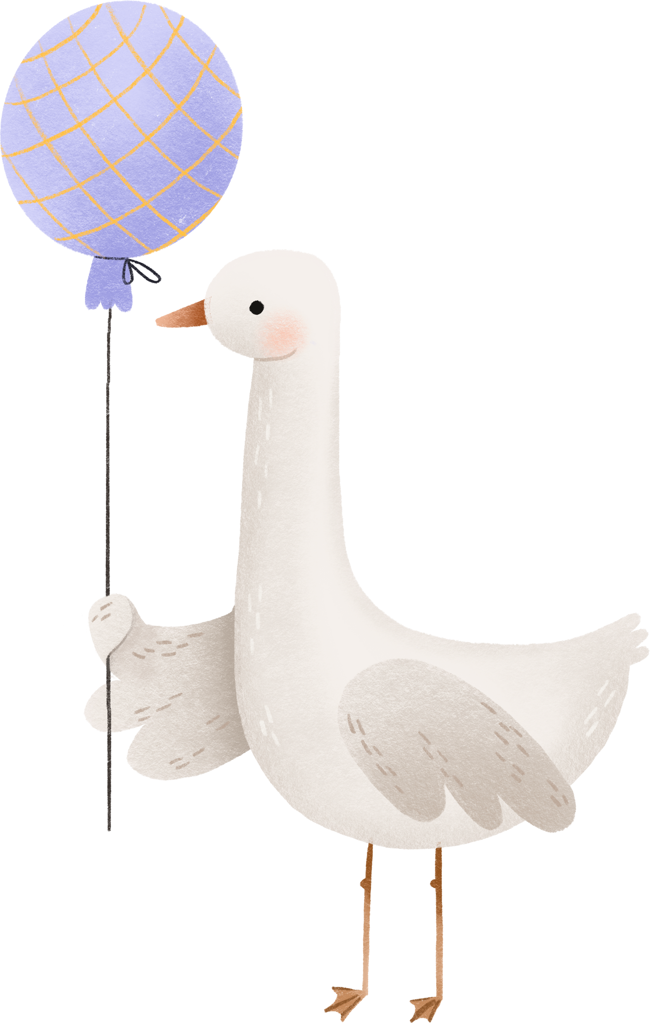
WELCOME TO
Olivia's
Baby Shower
03.19.2026

